Slide 1
Ames Lab Instrumentation Notification System
Scott Hood, Daniel Keith, Shiai Liu, Luke McDonald, Eric Graika
Notes:
Introduction
Say We are Group 11, Names of Teammates
Say who are client is (Matt Besser and Ames Laboratory)
“Our project is a Notifcation System for Laboratory Equipment”

Slide 2
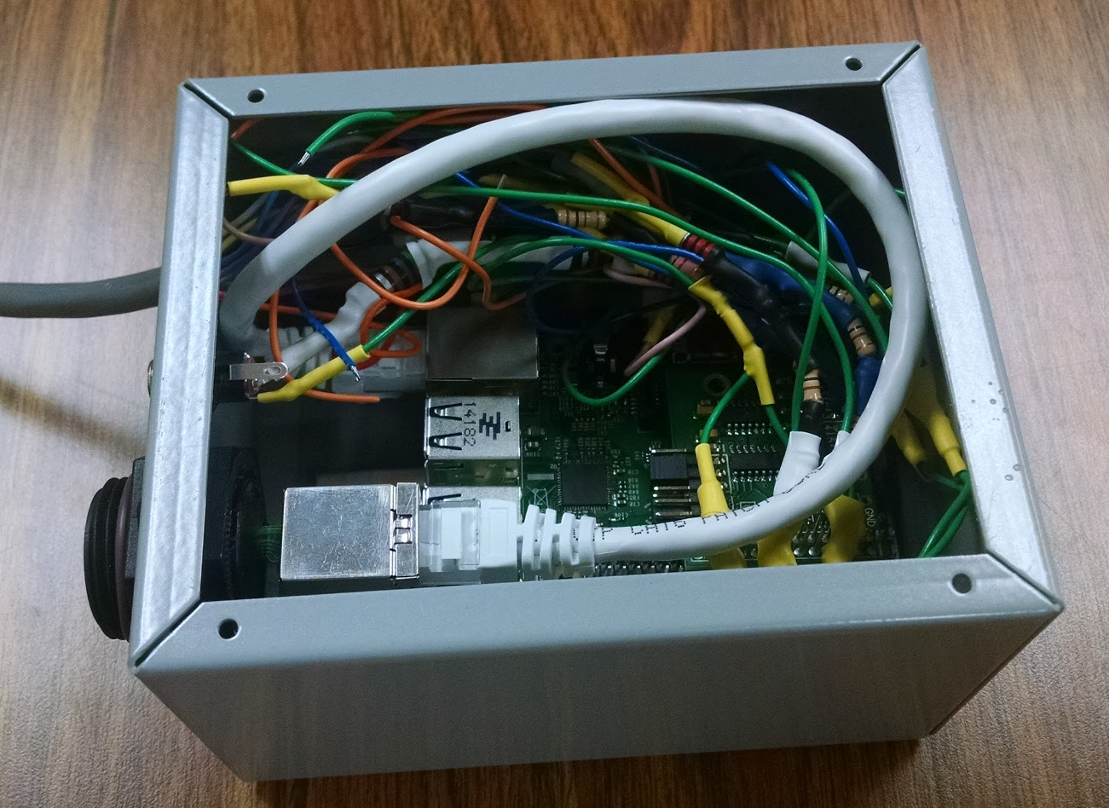
Project Explanation
Observation and Notification System
Collecting Data
Alerting Personnel
Reproducible
Cost Efficient
Notes:
We were asked to design a box that would read in data from multiple types of sensors, thermal, and pressure primarily, interpret that data, and send notifications out to appropriate personnel if the box thought something was wrong. He wanted a system that his intended users could easily configure when notifications should be sent out, and was easily checkable by not having to visit the room of the equipment every couple of hours.
Now before coming to us, Mr.Besser already knew that systems like this were already on the market. Ames Lab already uses a system that does most of his stuff the AVTech Room Alert System. However, this system costs around $900 dollars, and for the amount of rooms Matt Besser wanted to put a notification system in, this could get fairly expensive really quick.
So Matt Besser asked us to create all of this, but mostly, create something that was actually afordable.

Slide 4
Functional Requirements
Error Detection
Alerting Personnel
Experiment Session Data Collection
User Friendly
Affordable
Regular Monitoring System Cost: <$1000
$150
Notes:
So our requirements for this project were to create a notification system that could notify personnel via SMS text.
Collect short term data to show what happened during periods of the equipments run time.
An easy to use control module for the intended user.
And something that was affordably easy to reproduce using good documentation.
Now this we thought was all relatively easy to put together and create, so we decided to add a couple of more features on top of the ones Matt wanted.

Slide 5
Non-Functional Requirements
Viewing Near Real Time Data from Equipment’s sensors
Storing Long Term Data
Easy to check status of equipment
Notes:
We wanted to add that scientist could actually see real time data in graph and table format of what ever equipment the box was monitoring. This allowed for them to actually record and see data changes from their workspace rather than going down to the room itself.
We also wanted it to store long term data. Not simply short term but show the equipments entire run time, so that scientists could use and display this data in their research.
We also wanted to add a feature that used equations to determine the overall status of the equipment, detecting rates of change and could judge whether or not equipment was on its way to being in danger before the notification had even happened.

Slide 6
Constraints
DOE Security Expectations
Ames Lab Associates status
Required Training
Electrical Code
Networking
Firewalls
Notes:
One of the main constraints of this project was that we had to do it with regards to the DoE Security Specifications. We needed to make sure it was all encrypted and only visible by ames laboratory. This we found capable by allowing the system to be only viewed when on site or using a VPN to access the moderate enclave privileges of ames laboratory.
Achiving Associates status, it required us to go through multiple types of training, and fill out all the appropriate paperwork that allowed us the right to work on this project according to DOE standards.
Another constraint was us not being able to do our own electrical work and set up. Due to Ames Lab Rules for safety regarding students, we are not allowed to do any wiring from the sensors to the box.
The other problem was the networking, which was the establishment of holes through the firewall in order to create a connection between one type of subnet to another. Another example was making sure our group had access to the server that was housing our web application and database, for off site work.

Slide 7
Potential Risks
Maintenance
PI
SQL Table Management
Server Stability
DOE Requirements
Stable Connection

Slide 8
Sensor capabilities
Gas Transducers
0-5V , 0-10V, and 4-20mA com signals
conversion equation: y = mX + b
Thermocouples
supports K, R, S, T, J, and E types
Measure 0-1500C
0-15V signal
10mV/C conversion
Notes:
24-pin header is used for easy of movement to move the monitoring box from room to room. then quick to hook up since none of the wiring or programming need to be changed because the box has standardized pin assignments for the 24-pin header

Slide 9
Monitoring Box Details
Connects to equipment via 12 connector
ADC Pi
Collects 8 com signals from sensors
In 0-5V form
By voltage divider
Raspberry PI
Scales voltages
Sends voltages to Mysql database

Slide 10
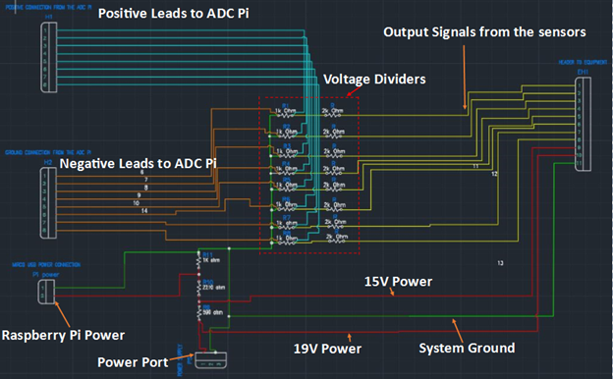
Hardware Visual
ADC Pi Positive
Com lines
ADC Pi Negative
Notes:
With all of this here is what we decided to create, two separate components that would handle the data collection which would be handled by the hardware and rasberry pi portion of the system, and a private server holding a database and web application that would handle the interpretation of data and notification system.
This visual represents one box that would take data from the sensors in the lab instrument be interpreted by a rasberry pi controller with a ADC Pi module attached, send the data through a firewall hole to the server which would input the data into a MySQL server and be interpreted by the Php web application.

Slide 11
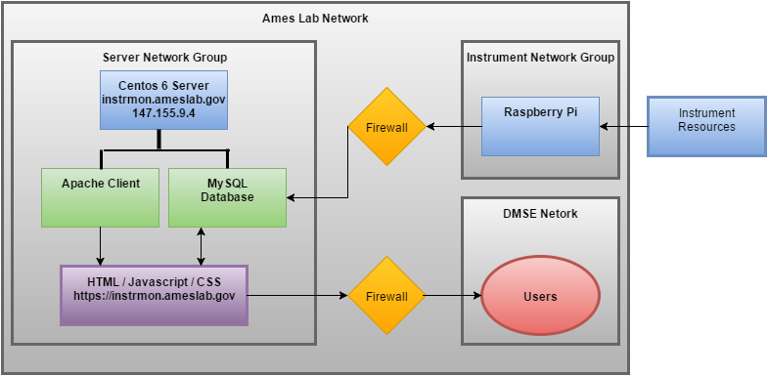
Network Visual

Slide 12
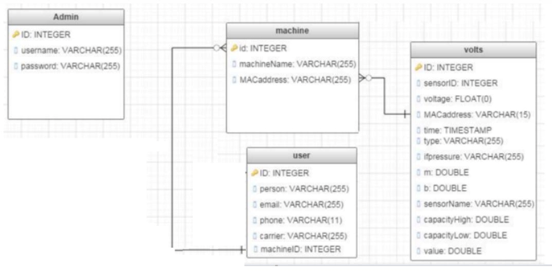
Database Structure

Slide 13
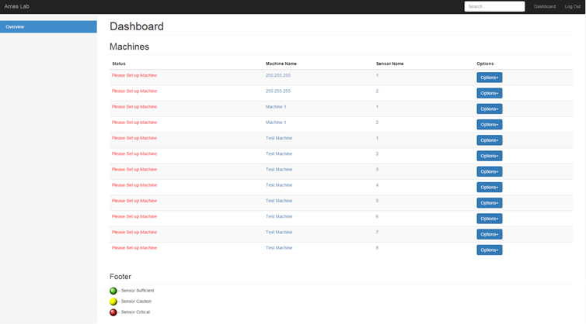
Details of the Website

Slide 14
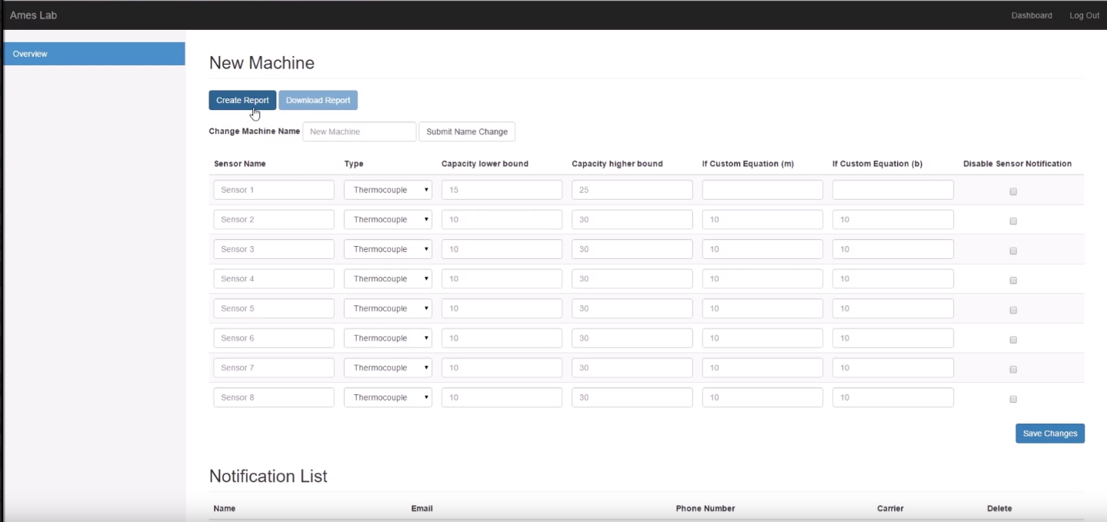
Configuration/Admin Page

Slide 15
Website Graphing Page

Slide 16
E-mail Alert System
Uses Crontab and PHP
Runs every hour
Looks through recorded values.
Checks for Errors
Sends Notifaction Using SMTP
Emails and Texts
Built in PHP Function Support

Slide 17
Testing
Phase 1 - Individual Component Tests
Testing Key Components Individually
Inserting Dummy Variables in SQL
Test interface functionality.
Phase 2 - Combined Short-term Tests
Testing Key Components Together
Controlled Short Term Tests

Slide 18
Changes During Project
ADC Pi channels were assigned sensor type for certain channels
Channel 1-4 K-type
Channel 5 R-type
Channel 6-8 Gas Transducers
Now, All ADC Pi channels are the same so any channel can get 0-5V, 0-10V, 0-15V, or 4-20mA.
How to send the data from the Pi to the database.
Database Design.

Slide 19
Questions?

